Slide 1
Dominoes Pizza Sale

Slide 2
Introduction
Hello, my name is Atharv. In this project, I am showcasing my SQL skills and practicing my abilities by creating a comprehensive database. I’ve developed queries, imported data, and utilized ChatGPT for generating questions, all to demonstrate my proficiency in SQL and my ability to analyze and present data effectively.

Slide 3
Project Goals
Create Database
Goal: Set up a SQL database named "dominoes" to store the dataset.
Import Data
Goal: Import a CSV file from Kaggle into the database accurately.
Develop Queries
Goal: Create and execute SQL queries at three difficulty levels (Simple, Medium, Intermediate).
Generate Questions
Goal: Use Chatgpt to create questions based on the SQL queries.
Analyze Results
Goal: Analyze query results and provide clear insights.
Prepare Presentation
Goal: Compile the project details into a concise PowerPoint presentation.

Slide 4
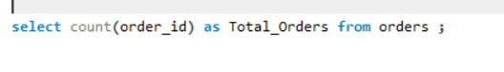
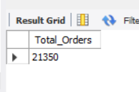
Retrieve the total number of orders placed.

Slide 5
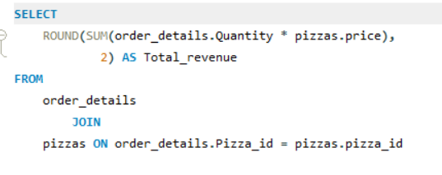
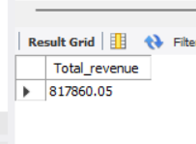
Calculate the total revenue generated from pizza sales.

Slide 6
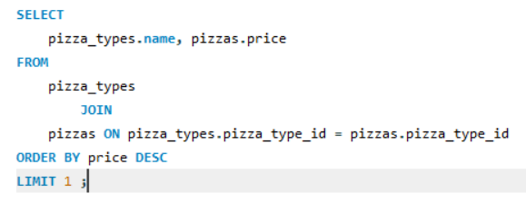
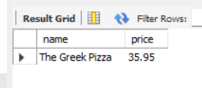
Identify the highest-priced pizza.

Slide 7
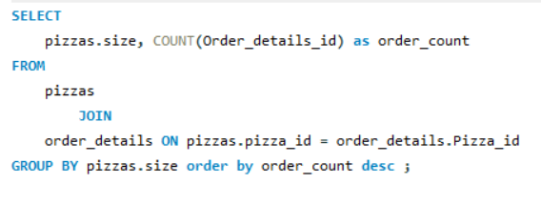
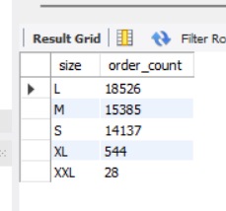
Identify the most common pizza size ordered.

Slide 8
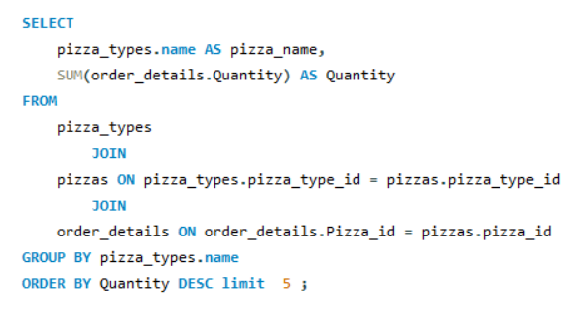
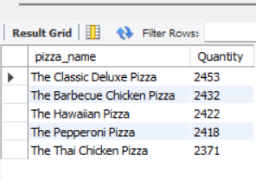
List the top 5 most ordered pizza types along with their quantities.

Slide 9
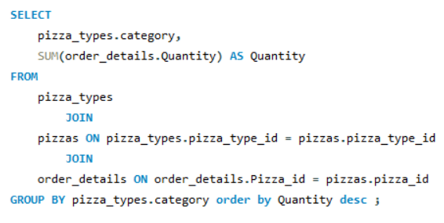
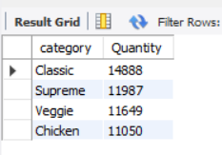
Join the necessary tables to find the total quantity of each pizza category ordered.

Slide 10
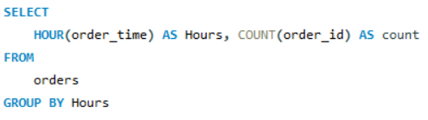
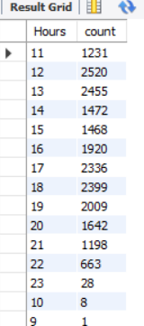
Determine the distribution of orders by hour of the day.

Slide 11
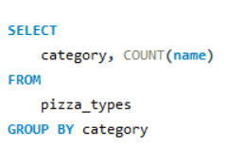
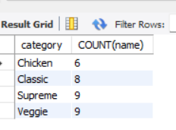
Join relevant tables to find the category-wise distribution of pizzas.

Slide 12
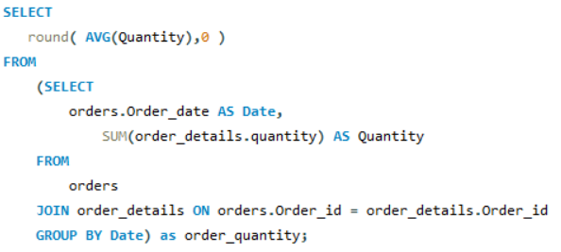
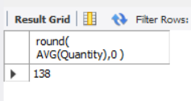
Group the orders by date and calculate the average number of pizzas ordered per day.

Slide 13
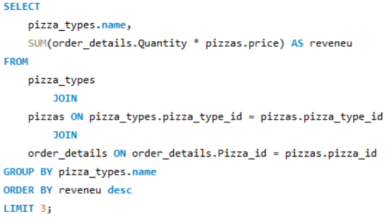
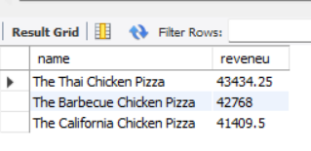
Determine the top 3 most ordered pizza types based on revenue.

Slide 14
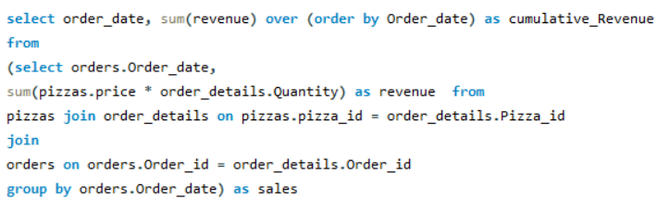
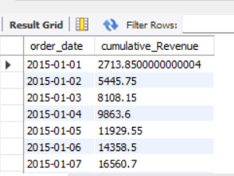
Analyze the cumulative revenue generated over time.

Slide 15
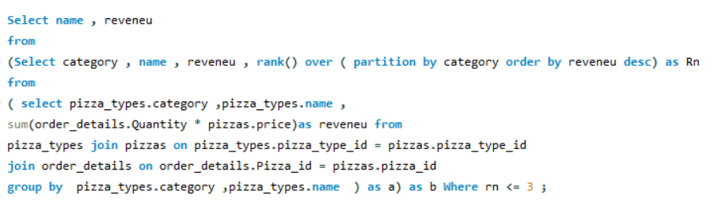
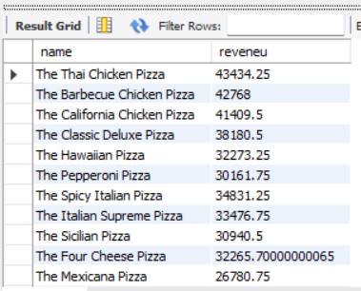
Determine the top 3 most ordered pizza types based on revenue for each pizza category.

Slide 16
THANK YOU

